Slide 1
Model Calculation of Two-dimensional Raman-infrared Spectroscopies
2021/12/10
D2 Hideaki Takahashi
Notes:
このようなタイトルで発表～

Slide 2
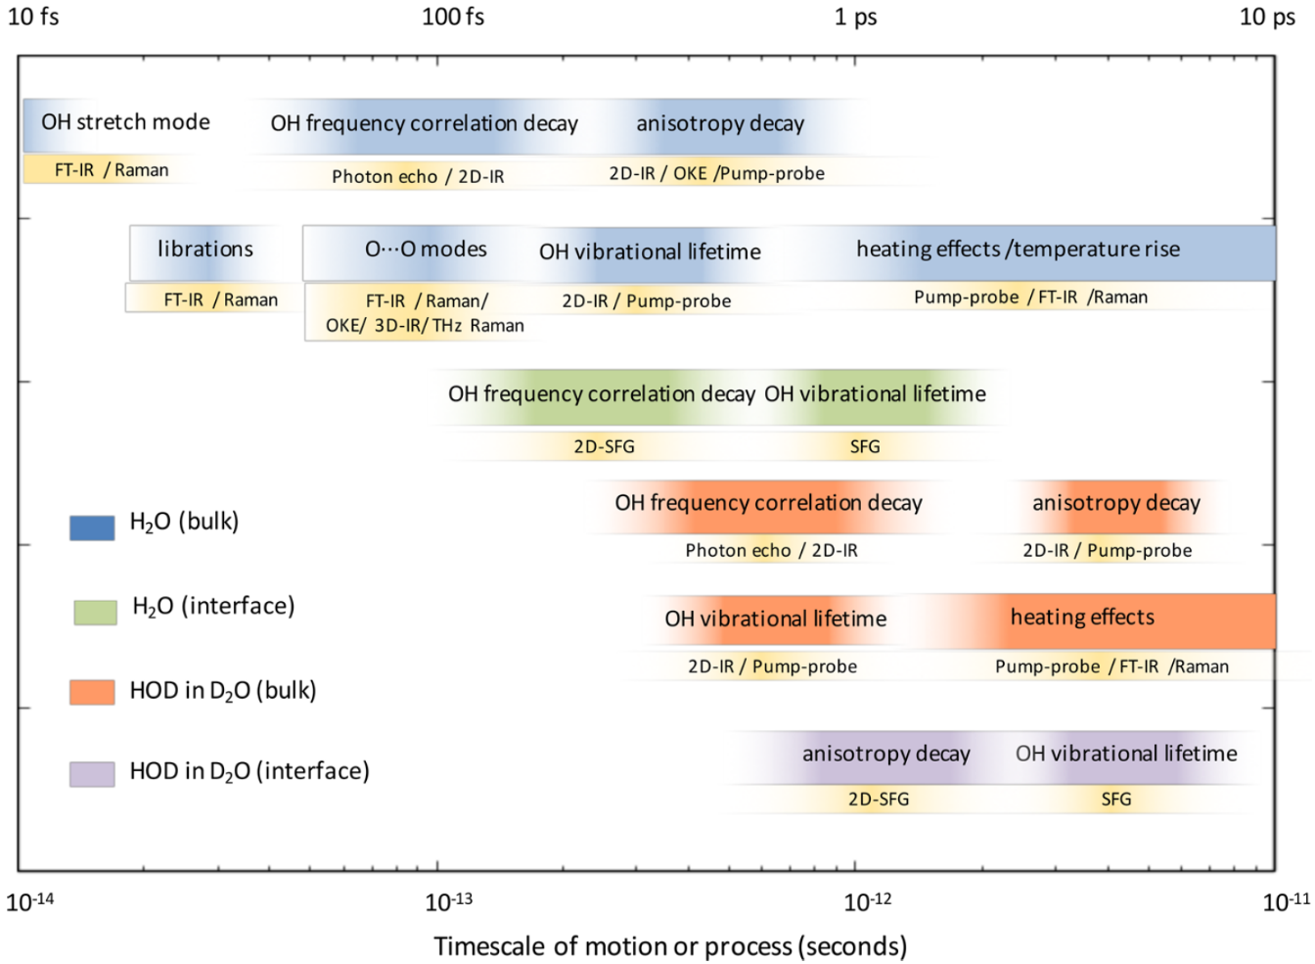
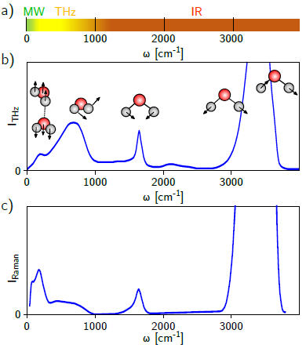
Timescale of vibrational modes of molecules
F. Perakis et. al., Chem. Rev. 116, 7590 (2016).
D. Sidler, Ph.D. Thesis (2020).

Slide 3
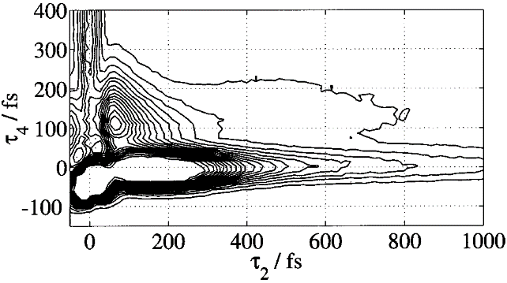
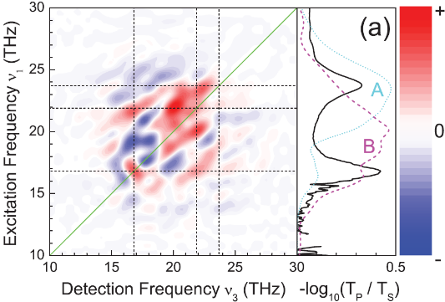
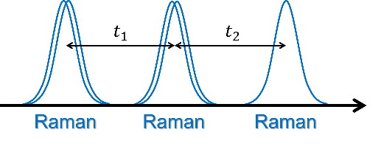
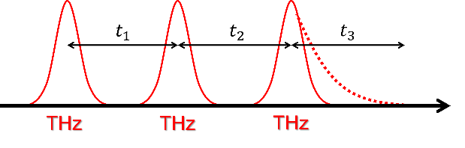
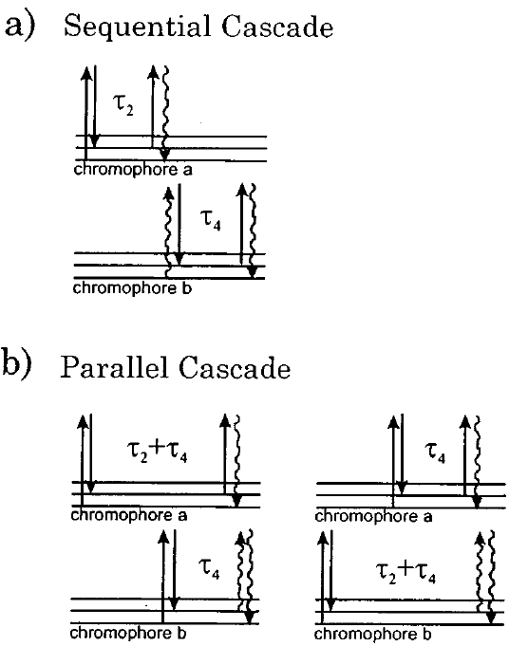
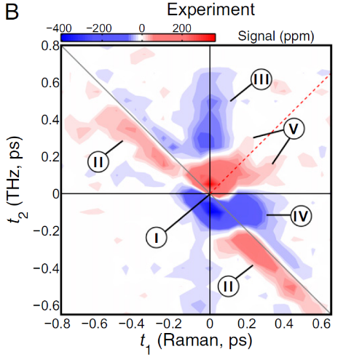
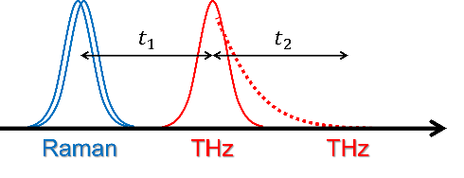
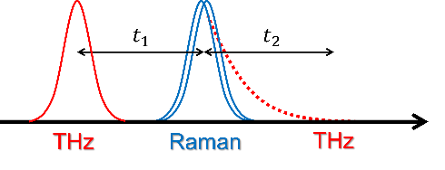
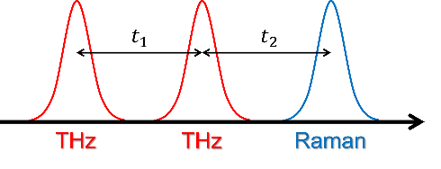
2D-Raman-THz
M. Cho, J. Chem. Phys. 111, 4140 (1999).
P. Hamm and J. Savolainen, J. Chem. Phys. 136, 094516 (2012).
2D Spectroscopies in the low-frequency range
・2D-Raman ⇒ Cascading problem
・2D-THz ⇒ Low pulse energy
D. A. Blank et. al., J. Chem. Phys. 113, 771 (2000).
W. Kuehn et. al., Phys. Rev. Lett 107, 067401 (2011).
・2D-Raman-THz
Circumvent these problems
D. A. Blank et. al., J. Chem. Phys. 111, 3105 (1999).
J. Savolainen et. al., Proc. Natl. Acad. Sci. U. S. A. 110, 20402 (2013).

Slide 4
2D-Raman-IR
M. Cho, J. Chem. Phys. 111, 4140 (1999).
P. Hamm and J. Savolainen, J. Chem. Phys. 136, 094516 (2012).
H. Ito and Y. Tanimura, J. Chem. Phys. 144, 074201 (2016).
Investigate a coupling between inter- and intra-molecular vibrational modes
Raman pulse + IR pulse (cf. 2D-Raman-THz)
⇒ cover a wide range of frequencies
Two-dimensional spectroscopies of vibrational modes
2D-Raman-IR
2D-Raman-THz
2D-IR
Intramolecular modes
Wavenumber
Intermolecular modes

Slide 5
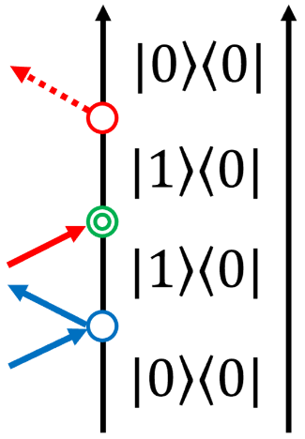
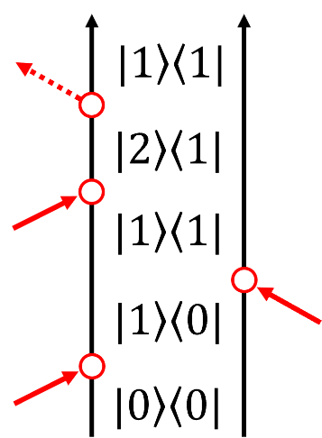
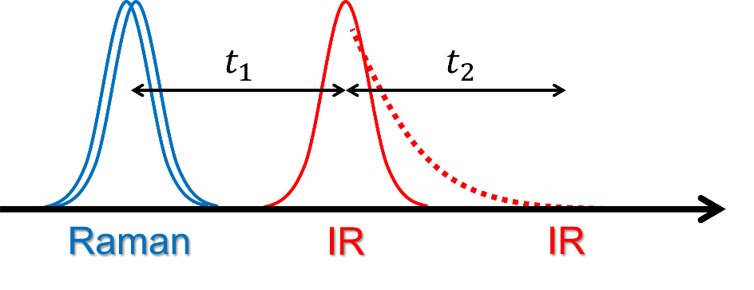
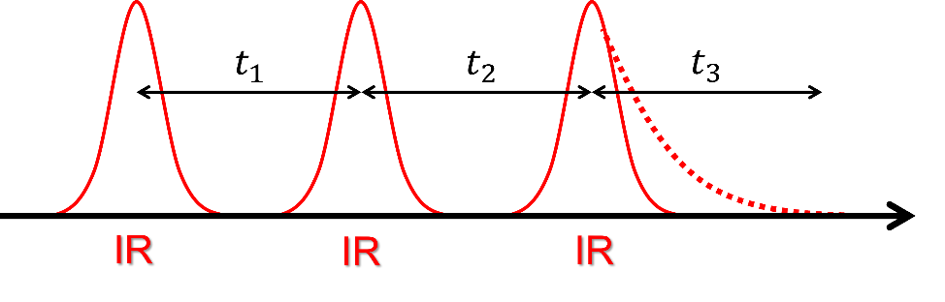
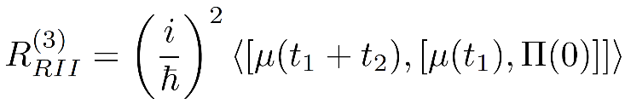
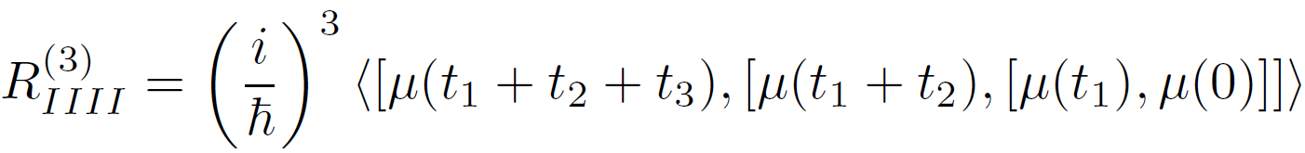
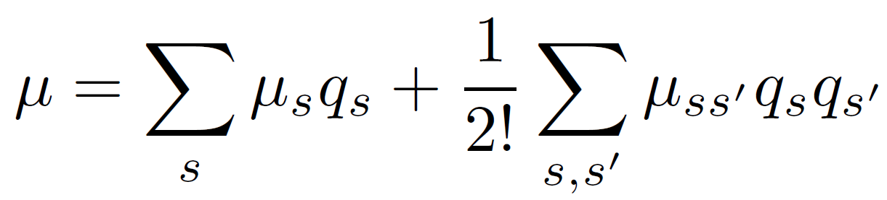
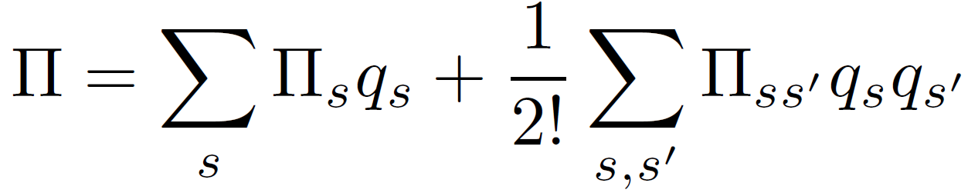
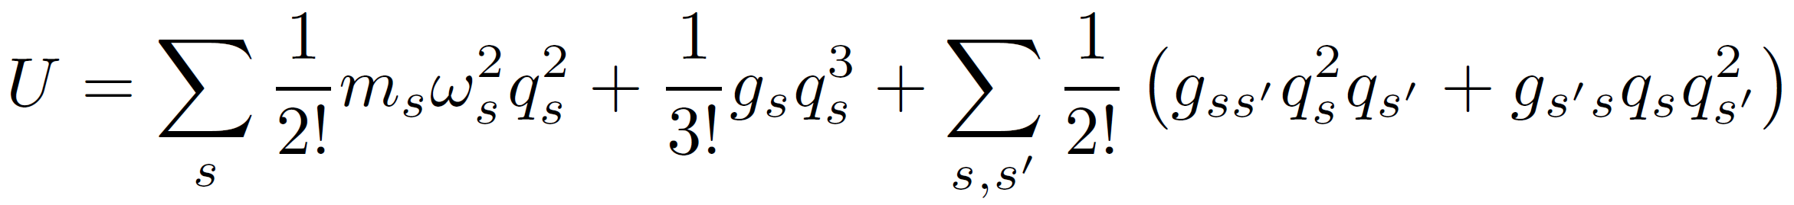
2D-Raman-IR
M. Cho, J. Chem. Phys. 111, 4140 (1999).
P. Hamm and J. Savolainen, J. Chem. Phys. 136, 094516 (2012).
H. Ito and Y. Tanimura, J. Chem. Phys. 144, 074201 (2016).
ex) Raman-IR-IR
cf. 2D-IR
⇒ Nonlinearity (NL) and Anharmonicity (AH) contribute to spectral peaks
Dipole
Polarization
Potential
Nonlinearity
Nonlinearity
Anharmonicity

Slide 6
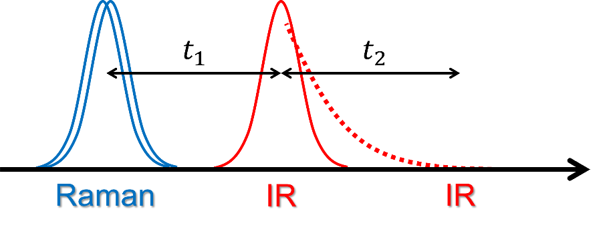
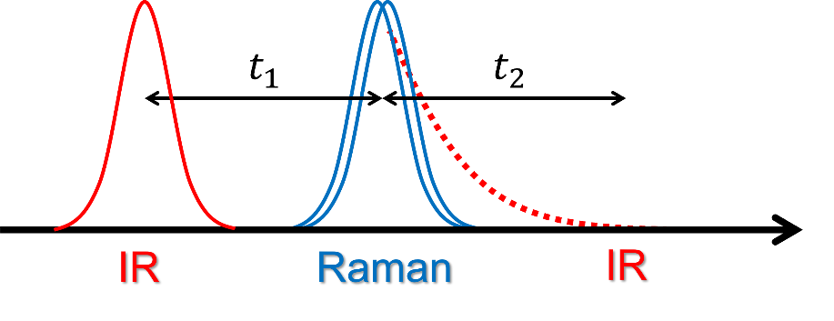
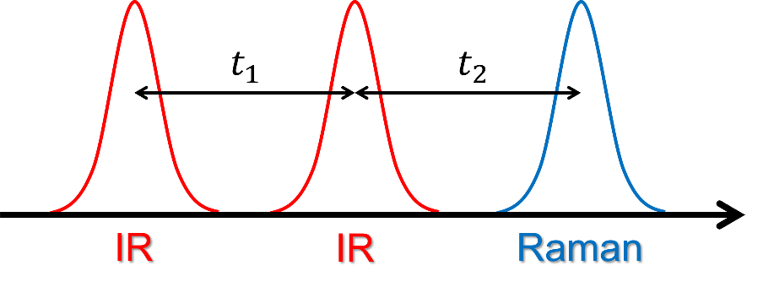
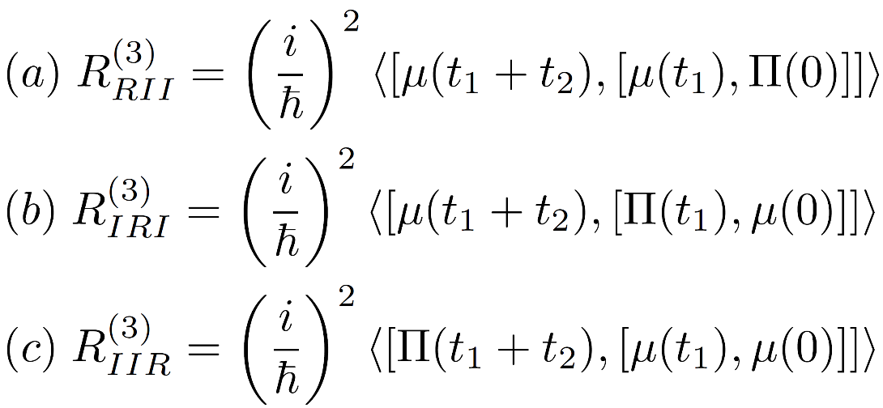
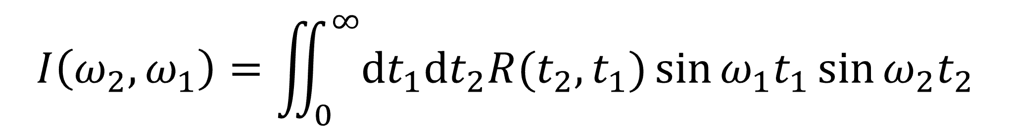
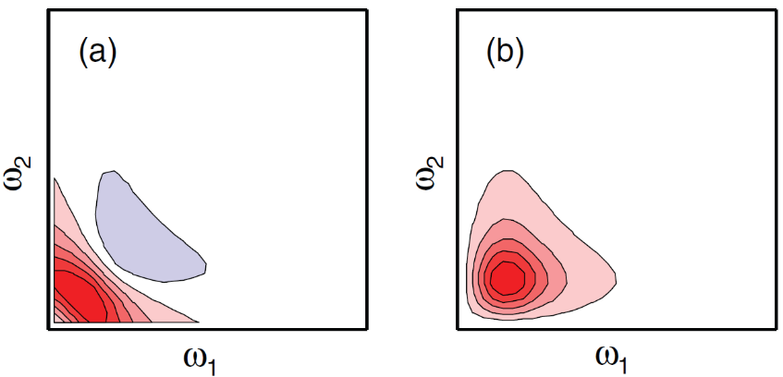
2D-Raman-IR
M. Cho, J. Chem. Phys. 111, 4140 (1999).
P. Hamm and J. Savolainen, J. Chem. Phys. 136, 094516 (2012).
H. Ito and Y. Tanimura, J. Chem. Phys. 144, 074201 (2016).
(a) Raman-IR-IR
(b) IR-Raman-IR
(c) IR-IR-Raman
Response Function
Spectrum
2D-sine-FT

Slide 7
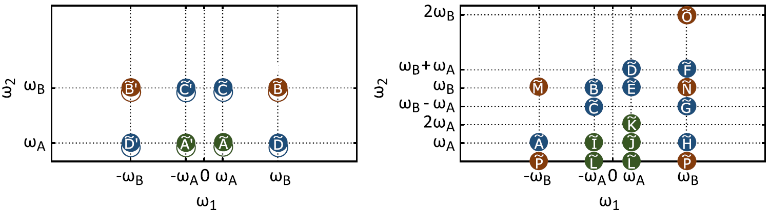
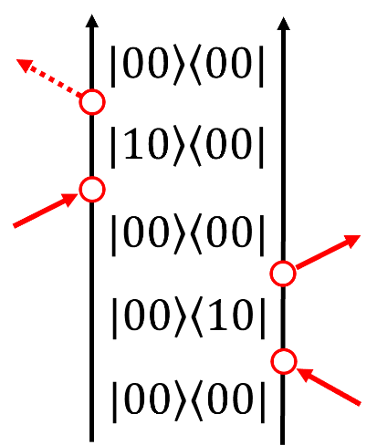
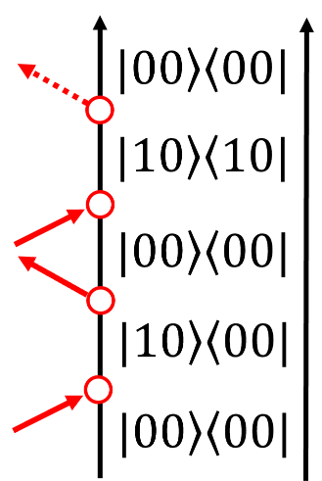
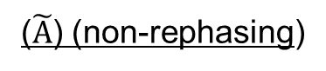
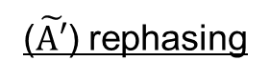
Complexity of 2D-Raman-IR spectrum
2D-IR
2D-Raman-IR
symmetry
ex)
($\tilde{A′}$) rephasing
($\tilde{A}$) (non-rephasing)
・asymmetric peaks
・overtones (Fermi resonance)
⇒ difficult to disentangle
D. Sidler and P. Hamm, J. Chem. Phys. 153, 044502 (2020).

Slide 8
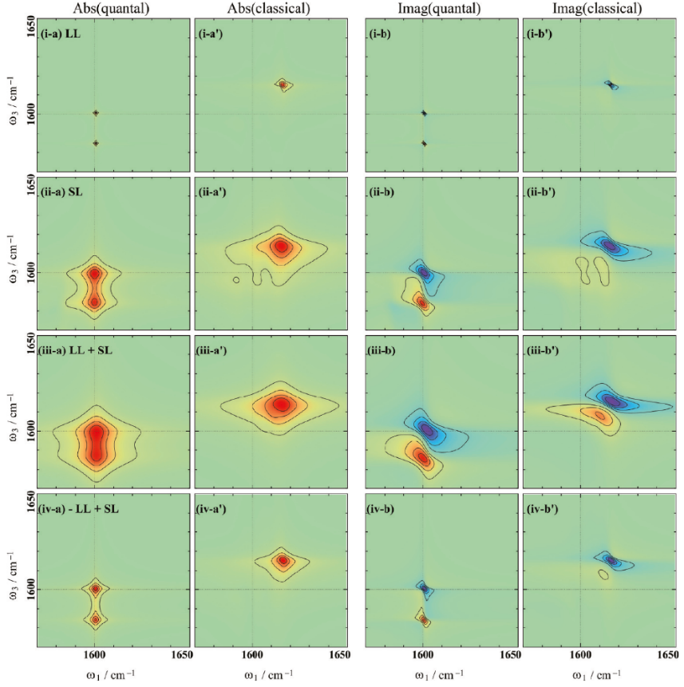
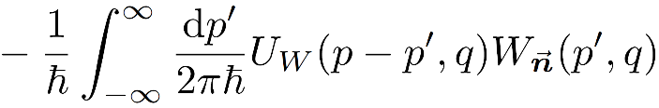
Theoretical problem
Both MD and model calculations have been performed only in the classical regime ⇒ Predict spectra correctly taking quantum effects into account based on system-bath model
2D-IR spectra of the morse potential system
1) Nonlocality of potential
2) Non-Markovian effect
Quantum effect is dominant in intramolecular modes
A. Sakurai and Y. Tanimura, J. Phys. Chem. A 115, 4009 (2011).

Slide 9
Today’s topic
*Only one mode case
1) Spectral features of NL and AH
2) Quantum effects

Slide 10
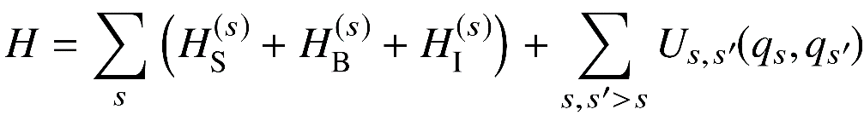
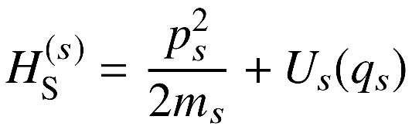
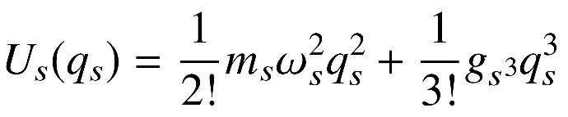
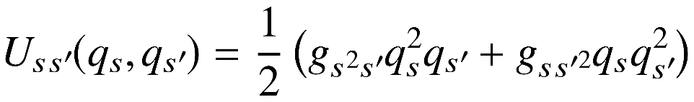
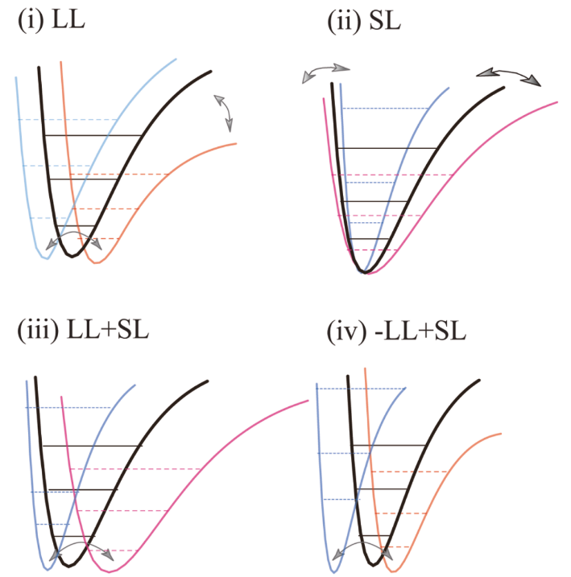
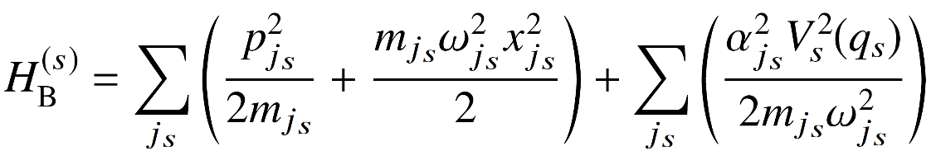
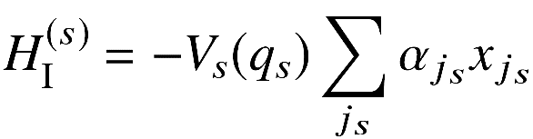
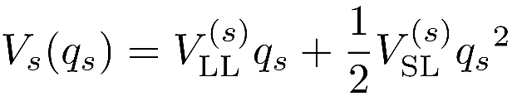
Model Hamiltonian
Total Hamiltonian
Hamiltonian of eachl mode
potential
Coupling between modes
Bath Hamitonian
System-bath coupling
A. Sakurai and Y. Tanimura, J. Phys. Chem. A 115, 4009 (2011).

Slide 11
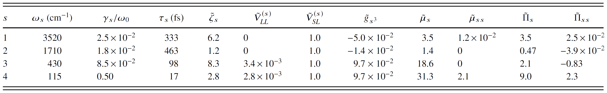
Simulation details
・quantum: HEOM (eigenstate representation)
classical: CHFPE
・Calculate 2D-Raman-IR spectra of one vibrational mode (ignore mode-mode couplings)
1) Spectral features of NL and AH
2) Quantum effects (liquid water)
H. Ito and Y. Tanimura, J. Chem. Phys. 144, 074201 (2016).

Slide 12
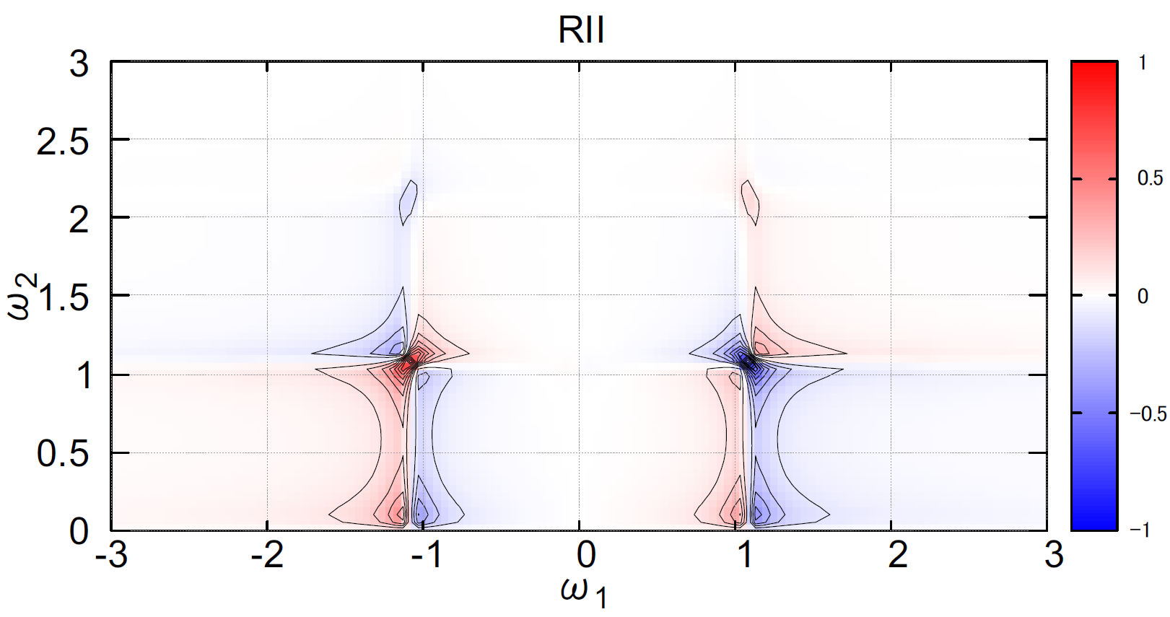
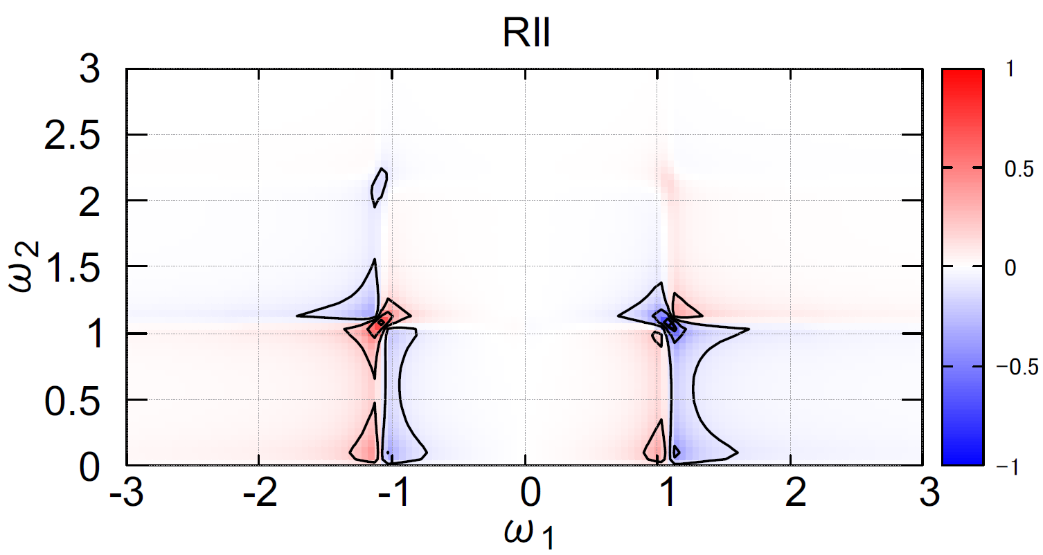
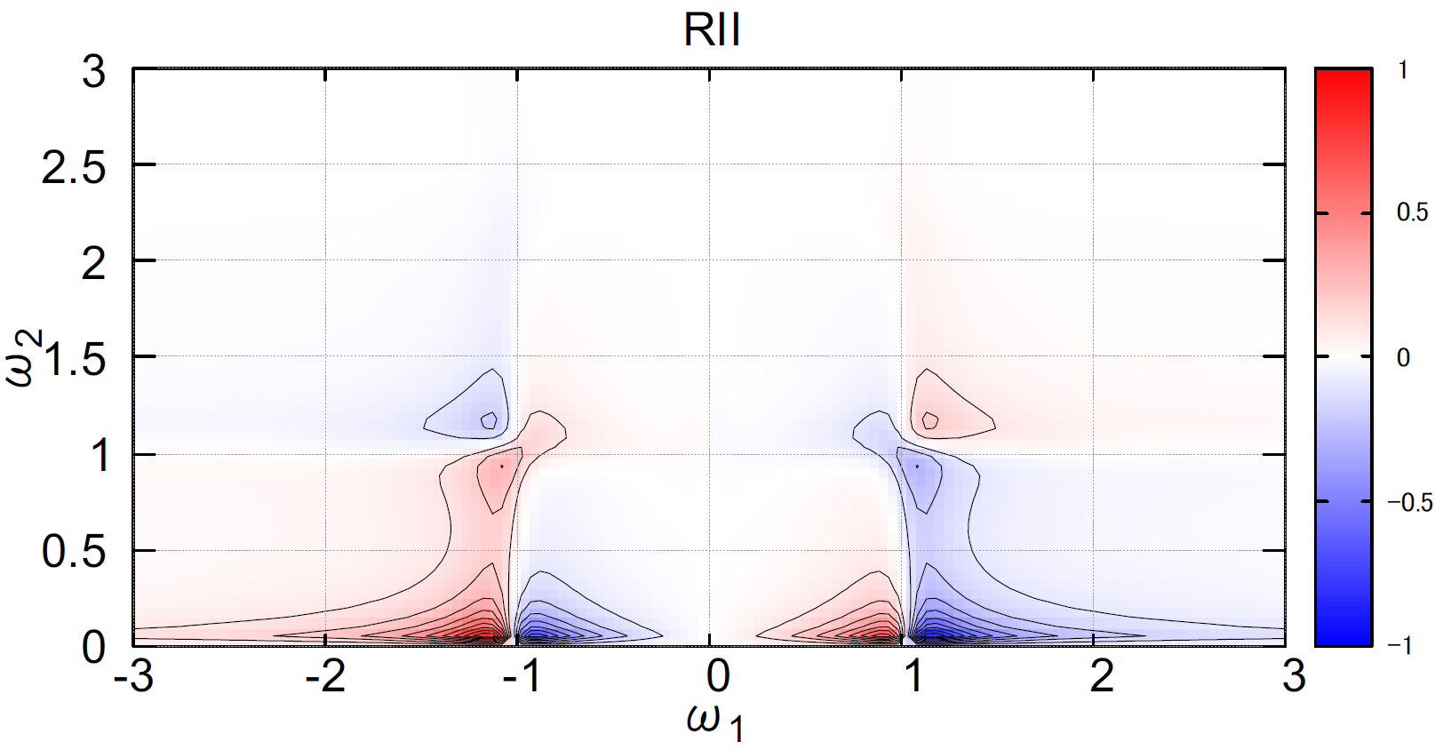
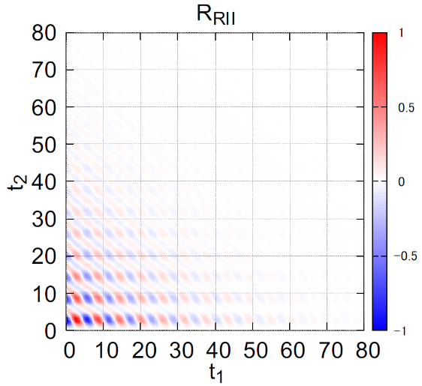
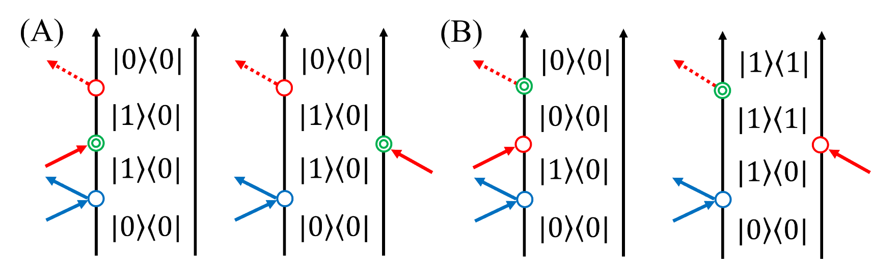
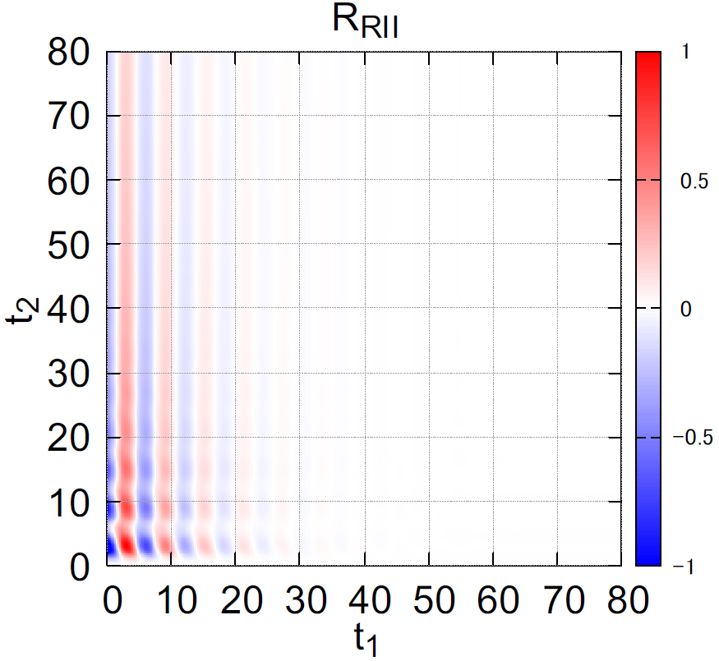

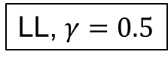

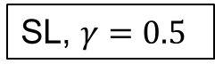
Anharmonicity ($g=0.2$)
LL, $γ=0.5$
SL, $γ=0.5$
(A)
(A)
(A)
(B)
(B)
(B)

Slide 13



Anharmonicity ($g=0.2$)
LL, $γ=0.5$
LL, $γ=0.01$
(A)
(A)
(B)
(B)

Slide 14




Anharmonicity ($g=0.2$)
SL, $γ=0.5$
SL, $γ=0.01$
(A)
(B)

Slide 15




Anharmonicity ($g=0.2$)
SL, $g=0.2$
opposite phase
SL, $g=−0.2$
・$I_{RII}^{AH}=I_{IRI}^{AH}=I_{IIR}^{AH}$
⇒ strong anharmonicity

Slide 16





Nonlinearity of polarizability
・RII ⇒ very weak signal${ max⁡(I}_{RII}^{AH}):{,max⁡(I}_{IRI}^{AH}):{max⁡(I}_{IIR}^{AH})≈0.06:1.0:0.7$
(C)
(A)
(B)
(A)
(B)
(C)

Slide 17



Nonlinearity of dipole moment
(A)
(A)
(B)
(C)
Raman pulse ×1
(B)
IR pulse ×2

Slide 18

Intramolecular and intermolecular vibrational modes of liquid water
IR spectrum of liquid water
Vibrational modes
① OH stretching
② OH bending
③ Libration
④ HB translation
①
intramolecular
intermolecular
③
②
④
T. Hasegawa and Y. Tanimura, J. Phys. Chem. B 115, 5545 (2011).
Vibrational modes ⇒ Brownian oscillators + Environments

Slide 19



OH stretching
RII spectrum
IRI, IIR: almost the same profile ⇒ AH is dominant
quantum
classical
(a)
(a)
(b)
(b’)
(b)

Slide 20


OH stretching
RII spectrum
IRI, IIR: almost the same profile ⇒ AH is dominant
quantum
classical
(a)
(a)

Slide 21



HOH bending
RII spectrum
quantum
classical
(e)
(c)
(d)
(c)
(d)

Slide 22



HOH bending
IRI spectrum
quantum
classical
(g)
(f)
(f)

Slide 23



HOH bending
IIR spectrum
quantum
classical
(h)
(h)

Slide 24
Summary
・Calculate 2D-Raman-IR spectra of a vibrational mode
・Demonstrate the features of 2D-Raman-IR spectroscopies
・Future work ・Calculate 2D-spactra of mode-mode couplings (in progress)
・Apply to liquid water (in progress)
・Design four-body correlation spectroscopies

